Slide 1
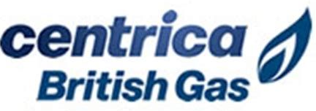
Centrica & British Gas – Account Summary
Client Details
Legal/Type | Public
Industry | Energy Services and Solutions
Geo Served | United Kingdom, Ireland and North America
Financials in 2019 | Rev: £26.82 Bn | Earning: £(1.03) Bn
No. of Employees | Employees: ~31 K
Founded in | 1997
Centrica plc is a British multinational energy and services company, its principal activity is the supply of electricity and gas to businesses and consumers in the United Kingdom, Ireland and North America.It is the largest supplier of gas to domestic customers in the United Kingdom, and one of the largest suppliers of electricity, operating under the trading names Scottish Gas in Scotland and British Gas in England and Wales. It owns Bord Gáis Energy in Ireland. It is also active in the provision of household services including plumbing.
Cognizant Engagement
Engaged Since:
2005
Onsite Locations:
UK
Offshore Locations:
India (Chennai, Bangalore, Coimbatore, Pune, Hyderabad, and Kochi)
Major works done at Centrica:
Standardization of desktop platform in 2006
Commencement of Digital journey through establishment of britishgas.co.uk in 2007
Provide Quality Assurance Services since 2008
Application support services since 2008
Field engineer helpdesk setup in 2008
Key digital solutions and mobile self serve delivered in 2010/11
Outcome Based and Catalogue Model for Application development since 2013
Application Portfolio Rationalization in 2013
Providing QA Services under Test Factory Model since 2013
Legacy Modernization for Home Services in 2014
Delivered SAP IS-U and CRM in 2014
Supporting ESI Smart Metering operations since 2015
Service operation transformation since 2015
Delivering Big data strategy since 2015
Cloud transformation since 2016
CC&B upgrade in 2016
Delivering Virtual Power Plant capabilities 2017
Automation CoE setup & RPA capabilities delivered 2017
Delivering Smart Meter roll-out & operations in DCC world 2017
Data Centre transformation to Nex-Gen Cloud 2017
Digital transformation to Next-Gen Web 2017
Major achievements:
25%cost savings through E2E Life Cycle Automation
15%Cost Savings through Intelligent Test Delivery Platform
25%Cost reduction through Intelligence box, Shift left Approach, Cross Skilling, Reusable Frameworks & Test Artifacts
Committed Transformation benefits of £10M over the life of the service transformation operation contract through automation, Six-Sigma techniques, analytics, portfolio rationalization, service consolidation
Digital Self service transformation resulted into 3.1 million registered customers, 2100 online registration daily, 25000+ logins daily, 1100 sales contacts generated daily, 900+ paperless billing sign-ups daily, 70000+ account notification generated and sent daily etc
Committed £2.2 annual savings on infra through cloud transformation program.
70+ applications migrated to Hybrid Cloud
6 mn Smart Meters installed
Strategic Initiatives:
Customer Experience Management – digital development and support since 2007
Application Based Pricing for AMS
Outcome Based and Catalogue Model for Development services
On-demand Model for QA&C Services
Service operation transformation
Delivering Big data strategy
Defined Digital strategy roadmap
IS integration of DE&P acquisitions
Digital platform for Partnerships
Driving clients strategy of global shared services through global delivery of Service Operations, QA & Environments Mgmt.

Slide 2

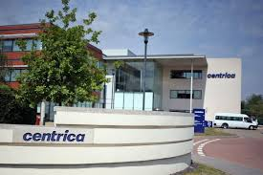



Centrica – Account Journey
INITIAL ENGAGEMENT
CHALLENGING THE ‘STATUS-QUO’
STRATEGIC PARTNER
DIGITAL TRANSFORMATION
Next-Gen Programs
ONE GLOBAL
One
British Gas
Transformation Programs
Show Me The Value!
SCALE & FLEXIBILITY
DELIVERING TO OUTCOMES
SKIN IN THE GAME
A GLOBAL DIGITAL PARTNER
An industry leader in
Digital consumer engagement
Leader in
Smart Meter rollout
Making strides in Automation adoption
Mastering
‘Silent Running’
Building a next-gen
Cloud platform
An on-demand
Testing CoE
75% positive feedback
60% transactions online
5mn meters installed
10k
installs everyday
350
RPA
bots
90
business processes
30%
incident reduction
30%
TCO reduction
35%
TCO reduction
139
apps in
Cloud
75%
Test automation
0%
defect leakages

Slide 3
Complex Project and Programme management for a leading Utility based in UK
Client: a British multinational energy and services company, its principal activity is the supply of electricity and gas to businesses and consumers in the United Kingdom, Ireland and North America.
Industry: Energy & Utilities
Region: UK
Business Process Overview Energy Services and Solutions
Engagement Highlights
Business Context
Solution
Outcomes Delivered
Large complex billing transformation program involving multiple teams including customer IT team who were executing parallel IT projects, business users and 3rd party IT vendors.
Teams followed various implementation/development methodologies –Agile/waterfall/ASAP, hence tracking and aligning timelines in a single place was challenging.
.
Cognizant set up & executed the PMO, established integrated project planning, collaborative risk management, comprehensive RACI Matrix, pre-defined escalation paths and governance forums. .
Established common understanding of project objectives and schedules with all the stakeholders
Effective and swift resolutions
Efficiently manage and track dependencies
Exchange visibility to program progress
Bring in Transparency
Perform course correction upfront
Aligned ownership and expectations with all stakeholders
Early view of potential issues across stakeholders
Metrics driven risk mitigation process
Notes:
Sunrun

Slide 4
Centrica Smart Meter Roll-out
Business Context
Solution
Outcomes Delivered
UK Energy & Utility market is embarking upon Smart Meter Implementation Programme.
The programme would see rollout of Gas and Electric Smart Meters for Residential and Business customers. One of the biggest suppliers in the UK, a Big 6, has a mandate to rollout 20+ million Smart Meters to its 15+ million customers and deliver Smart Experience post rollout.
The challenge lies in managing huge volume of rollout, variety with regards to meter specifications and rollout phases (SMETS 1 & SMETS 2) and maintaining the installed meters to deliver Smart Experience without breakdowns.
Cognizant designed an Operating Model that would deliver all critical capabilities required for successful roll out and operations of Smart Meters; including business capabilities, technical capabilities, operational capabilities and organizational capabilities.
To deliver to the capabilities and the operating model, Cognizant established a service based on Service Ownership ethos, that focused on business outcomes. A consulting based approach helped Cognizant guide the client to foresee the changes arising from the varied phases of Smart Meter Implementation Program and address the impact in client’s business and technology operations.
In addition to managed the technology stack of AMI/AMM solution, MDMS solution, Pre-payment solution etc., Cognizant plays a critical role in supporting the business operations team in dealing with challenges arising from varied processes including install & commissioning, billing, customer experience etc.
Smart Meter Rollout – Client is a clear leader in Smart Meter rollout in the UK with more than 5mn installs, which is ~60% of total Smart Meters installed in the UK.
Install & Commissioning – Client is able to rollout 10000 new Smart Meters each day with close to 100% first time success
Accurate Bills – Client is able to deliver to the commitment of 100% accurate bills to Smart customers
Smart Experience - ~100% Smart Meters (incl. devices) are on the latest versions ensuring enhanced experience to customers.
Notes:
Sunrun

Slide 5






Meter Data Management System Migration for a large UK Energy Supplier
Business Drivers
Legacy MDMS (MDUS-OSISoft) was unable to support reads and alerts data beyond 5m smart meters
New MDMS (Meterflow – AMT Sybex) was required to support rapidly growing large volume of smart electricity and gas meters and scalable upto 20m smart meters of multiple specifications (foundation as well as enduring)
Data migration solution required minimum disruption to business operations dependent on legacy MDMS solution before go-live
Key Highlights
Data from over 4m smart meters (2.2m customers) migrated
Solution Highlights
For data migration, Cognizant :
Created in-house solution for extraction and transformation (conforming to complex data model of the new system) and used loading tool supplied by new vendor Designed data migration strategy
Implemented an approach which required no extended downtime of older MDMS system thus reducing cutover time
Defined testing strategy, dress rehearsals planning, cut-over strategy and quality assurance
Extraction and transformation solution ensured that duplicate records existing in legacy solution was removed successfully thus ensuring cleaner data in the new system.
2 Years of historical data migrated (1.5 TB)
Minimum business downtime and high data quality
Technology Stack: Java, SQL
Business Outcome
Automated extraction, transformation and loading of smart meter reads into the new MDMS platform thus reducing manual effort required for migration.
Minimal disruption to business and customers. Speedy decommissioning of old infrastructure (legacy MDMS) as high quality data migration was achieved and there were minimal data related incidents
Enhanced scalability resulting in better readiness for large-scale smart meter rollout
Notes:
Centrica

Slide 6
SAP based Business Transformation Program in B2B Energy area
Client Profile
COGNIZANT’S SOLUTION
Client is a UK based energy supplier; it serves 16 million residential electricity and gas customers in that Country. It also supplies electricity and gas and energy related services to 954,000 businesses. Other Operations include gas and electricity production, wholesale energy marketing, international retail energy Marketing, drain cleaning services, and appliance sales
Business aligned solution
Delivering Business Outcomes for a Fixed Price as Quoted
Minimize Risk , Business as usual and Maximize out of the box compliance
Scalable Solution, multi tenancy architecture to support future business changes
Collaborative approach
Management of overall Program under a single PMO and multiple integrated work packages for smooth management and regular monitoring
End to End Delivery Ownership by Engaging and managing 3rd parties and internal
Focus on Quality and Satisfaction
Leveraging Cognizant’s global delivery model with 70% offshore ratio
Employment of lean processes and Leveraging Cognizant 2.0 Upgrade and tools
Partner relationships
Partnering various Practices like SAP, DWBI, J2EE, Business Consulting and Testing
Business Challenges
Client was facing multiple challenges with their Business Customer Segment (SMEs, C&I), customer experience, inefficient Processes, Billing Accuracy and Revenue Leakage. The utility recognized the need for a business Transformation which would provide them the following stated objectives:
Billing Accuracy - Improve the accuracy of our billing to ensure we get every bill right first time.
Service Levels - Support the improvement of customer service and reduce complaints to ensure we have the most satisfied customers.
Online - Provide an integrated online presence to reduce the cost to serve and provide an alternative account management option to satisfy our customers.
Controls - Ensure system controls and validations are in place to protect our customer data.
Benefits
Improved Customer Experience
Improved Process Efficiency
Management of Costs and Controls
Stable Platform for Growth

Slide 7
Salesforce Marketing Cloud Integrated Solution for Energy and Home Services
Client: Smart home technology provider based out of UK
Industry: Energy & Utilities
Region: UK
Business Process Overview
To implement a marketing automation solution to enable Connected Homes to market to their customers, on a global scale. Integrating the marketing solution to all platforms so the client has maximum reach to all its customers
Engagement Highlights
Technology: Salesforce Marketing Cloud
# of Business Users: 30 Project Duration: Ongoing
Team Size (On/Off): 6/2 Dev. Methodology: Agile
Tools/Accelerators: SFMC Marketing Cloud, Kettle
SITUATION
SOLUTION
SATISFACTION
Client wanted to effectively market to its customers with relevant communication at the right time. This resulted in need for Marketing Automation solution that will integrate with CRM, web shop and Legacy system of existing and new business
Build a hands off automated multi channel customer communication journey’s strategically targeting customers with relevant, personalised comms, with multiple touchpoints based on customer behavior
Client needed a centralized customer preference center to align with the new GDPR rules, and one where customers could control from different sources
Necessary bi-directional data flow between various 3rd Party systems
Migrate real time transactional coms from CRM to SFMC to reduce costs incurred by salesforce for sending out emails using the CRM system
Implemented Salesforce Marketing Cloud for the client, with multi-org. This enabled us to synch different CRM environments to different Business Units. Synched SFMC with test and prod CRM environment which was a big win
Integrated with Honey Comb platform to give a better picture of what the customer not only has ordered, but how they are also using their devices which enables for far more better personalised content.
Used API’s to migrate real time emails into SFMC
Used API’s to allow third parties to kick customer journeys
Designed and implemented several automated journey’s targeting customers at various point of their customer journey
Implemented Kettle solutions to support one-time/ batch bulk data operations
Integration with Staging Database to include global customers into marketing communications
Improved global customer reach and communication
Customer base growth along easy cross selling of products to existing customers
Improvement of CSAT due to easy processes and linkage of CRM data with usage data
Over 10.5M communications sent out to 1M+ customer across the globe.
Saved time of Call Centre agents by sending out service outage emails
Cost saving by migrating emails from the CRM into Marketing Cloud
Notes:
Hive- Centrica

Slide 8
Centrica | Connected Homes
Client Situation
The Client is the UK's leading energy supplier, and serves around 21 million homes in Britain. Connected Homes portfolio in Centrica is the leading Home Automation service provider in United Kingdom. The new sub brand provides heating product that allows to control your heating from your mobile, tablet or PC.
CLIENT
BACKGROUND
Client was looking for a QA Partner capable of understanding their complexities and test their connected devices and apps. Client was also looking to implement a test automation framework to accelerate testing and identify other areas of improvements and define a transformation roadmap to bring further cost benefits
BENEFITS
TECHNOLOGY
End to End Automation with BDD Framework
Quicker solution signing off for the new products achieved by leveraging SD UI
Cost savings of approx. £75,000+ (by leveraging in-House Mobile device farm)
Costs savings of approx. £14,000+ (by using Raspberry PI instead of procuring more terminals)
Specialized Testing :
Hardware Device Testing
Protocol Testing
OCR/LUX/APS validation Testing & Functional/Regression Testing
Mobile / Web Client Testing
Security Testing, Functional/Regression Testing, Interruption Testing, Penetration Testing, Accessibility Testing & Monkey Testing
Technology:
BDD - behave
Selenium
Appium
Python
Jenkins
JIRA
Test Rail
Github
Raspberry Pi
SOLUTION
Cognizant developed and implemented an advanced integrated BDD test automation framework using Python-Behave to test API’s devices, iphone, android and web apps.
Automation/Manual functional &regression testing were performed across devices , Mobile and web clients for the 9 kit combination for HUB
Some other key enabling solutions to overcome client’s discrepancies include developing in house Mobile device farm, Continuous integration with Jenkins, Rasperry pi installation for continuous test with live reports on dashboard portal.
Implemented TestRail and integrated with JIRA in the Connected Homes space for effective tracking
Key Stats:
19 hardware devices
51 Firmware releases
25 App releases
991 Test cases created

Slide 9
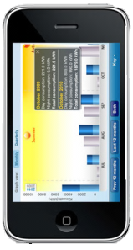
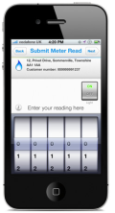
Energy Metering App for a British multinational Utility Company
Challenges
Solution
Outcomes Delivered
The client’s vision for a mobile apps was as follows:
A mobile app for residential customers to manage their energy and service accounts
Have apps for both iPhone and android phones.
Make mobile as an additional channel for the online website
Support functionalities like Submitting a meter read, viewing the account summary, viewing the Payment History, viewing the consumption as a graph and Book appointments for engineer’s visits
Key Solution Features are:
Extensive UI functionality with easy of navigation to details with touch functionality wrapped in native mobile applications targeted for iPhone and Android devices.
Features included submitting meter read, energy usage, comparison study, book an engineer with status tracking with optimal use of hardware features provided by smart phone devices viz. torch, call from application etc.
Primary benefit is significant adoption of the online platform. Key details are:
15% of traffic to the website site comes from mobile devices.
About 25% of emails are opened on mobile.
16% of online customers are now using this mobile app solution
Currently has a 4.5 star rating on Apple’s App Store and 4.6 star on Google Play.
More than 630,000 customers use this app, since its launch 4 years ago.
Notes:
Sunrun

Slide 10
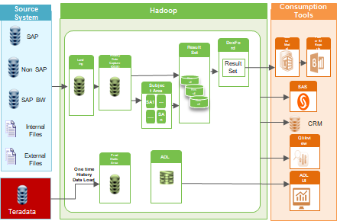
Data Lake on Hadoop for Downstream Systems @ Leading Energy and Home Services provider
Business Drivers
Value adds/Enablers
Enable cost-effective data warehouse solutions at enterprise level using Big Data
Improve SLA timeline for data availability for MI reports and analytical platform
Single point for Enterprise data storage and data consumption
Data Tap: Tool for dynamically detecting metadata and facilitating ingestion of Data into Data Lake
Diff Calculator : Tool developed for identifying data differences used for implementing SCD type 2 logic in Hadoop
History capture framework : A generic framework to Ingest data, identify data difference and implement SCD type2 logic
Solution Highlights
Designed and developed a data warehouse on hadoop with data ingestion technique by incorporating solution accelerators like Data Tap, Delta calculator & History capture
Data ingestion to Hadoop from Teradata/ SAP and non SAP systems
In-house tool for metadata management
Automatic data reconciliation, schema evolution on data lake, workflow management system providing restart-ability from point of failure
Technologies: Hortonworks |Hive| Pig | Kafka |Flume| Sqoop | Ranger | Apache Tez| Hbase
Learning / Best Practices
Define a data ingestion strategy which can be applied for multiple data sources
Set up a data ingestion team to ingest legacy data into Data Lake
Selection of technologies suitable for Data Ingestion, storage etc. to be done based on a small scale POC-
Define a standard framework for error handling, logging, exceptional handling etc.
Define a clear use case of the data that is planned to be ingested into Data Lake
Key Highlights
10M + customer data processed daily
10K+ tables,25+ sources data processed daily
Total data volume 10+TB/d and aiming to process 20+TB/d
Business Outcomes
Initiator for adoption of data lake on Hadoop in UK
98% resolving data inconsistency between different data warehouse systems
65% cost savings for IT services
50% improvement on SLA timeline on data availability from warehouse

Slide 11
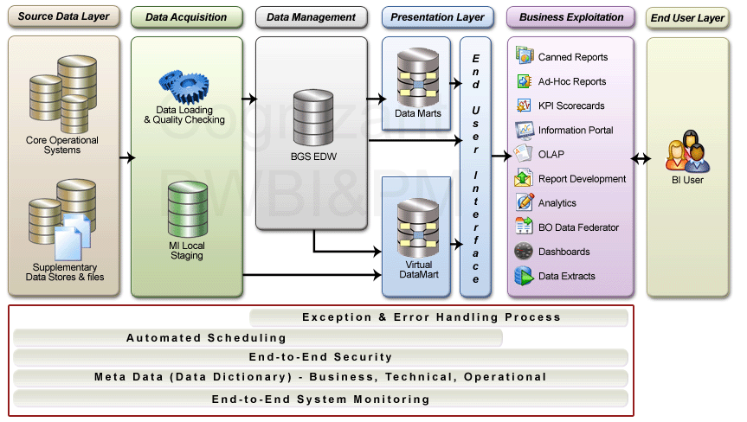
Centrica - BI Implementation Experience
BUSINESS NEED
SERVICES OFFERED
BI Implementation
The client had envisioned a BI program that would offer a flexible and scalable solution to cater to the growing business needs
To eliminate the need for manual reconciliation of data from disparate sources and empower the business users with a single version of truth
Provide solution to business that is achievable faster
COGNIZANT’S SOLUTION
Cognizant proposed a parallel-phased approach to the BI implementation and worked with business analysts, SMEs and an external vendor (part of High Level Design) on Requirements due-diligence and completed prototype validations and mock-up reports.
A structured knowledge transition and planning was conducted in order to gain thorough understanding and knowledge on requirements and high level design
In parallel to prototype development, detailed requirements gathering and analysis were conducted
Detailed design was carried out on ETL and reporting fronts including Physical data model design, ETL rules and transformation using BO Data Services and BO XI 3 components like Universe Designer, Web Intelligence, Dashboard Builder and Data Federator.
Platform set for BO Data federation
ETL data flows and BO universes and reports are developed to cater to Marketing, Insurance and Safety reporting needs.
System testing to be carried out by Cognizant as part of Build Factory testing and provide defect resolution during acceptance testing conducted by the client.
TECHNOLOGIES
BO Data Services, Business Objects XI 3.0 (Universe Designer, Web Intelligence, Dashboard Builder and Data Federator)
Netezza NPS 4.x
KEY HIGHLIGHTS
A foundation to the BI program envisioned in future phases
BI capabilities creation on the BO toolset, allowing for easy and flexible manipulation of data from various internal source systems
A sandpit environment to allow other data sources to be federated with the warehouse data
Cost-efficient delivery solution through the utilization of Cognizant’s flexible Onsite/Offshore Delivery approach and resources.
BO Data federator solution provided for faster solution to business

Slide 12




Centrica | Large cloud transformation (1 of 2)
CHALLENGE
SOLUTION
OUTCOME
Company Wanted To Accelerate Its Digital Vision (All in Cloud’ by 2021) By This Program To Transform Its IT Infrastructure To A Modern Managed Hybrid Cloud Solution Providing An On-demand Cloud Service On Consumption Based Pricing.
Approach
DIGITAL READY VISION | Multi-Cloud with Cognizant as Single Integrator providing seamless holistic service Comprehensive Automation / AI Platform for cost, risk reduction & time to deploy
SUPERIOR CUSTOMER EXPERIENCE | self-service and automation based deployments within one hour (improved from current levels of 12-16 weeks).
AS-A-SERVICE FUTURE MODEL | Hadoop as a service SAP as a service DevOps as a service
Solution Highlights:
Simplify
Application Portfolio Assessment
Hybrid Cloud Foundation
Modernize:
Application Modernization Program
Cognizant Private Cloud – Converged infrastructure consumed through a service catalogue on demand model.
Hybrid Cloud Automation & AI through Hive centre
Secure:
Managed Security controls and operate services across Public and Private Cloud.
Cognizant team carried out the Application Portfolio Assessment, identified Application Modernization touch points, established Hybrid Cloud Foundation and Automation and Managed Security controls.
Notes:
Centrica

Slide 13








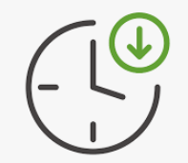
Program success
Centrica | Large cloud transformation (2 of 2)
Modernized the Landscape
Faster Time to Market
Operations Resilience
200+ Business Services
migrated to Cloud
Annual savings by reduced Server provisioning time
12 ‘weeks’ to 4 ‘hours’
Increased revenue by Redesigned pricing process
70% of Legacy Systems
De-commissioned
60% of transactions through next-gen digital platforms
50+ Self Service catalogues and integrated operations
10M+ customer data processed daily Data Lake on Hadoop
Quick Adaptability to
New Security Controls
Improved Mean Time to Repair by 30% & First Level Resolution by 70%
Notes:
Centrica

Slide 14
Building competitive edge for a leading utility in the UK in partnership with Microsoft through a large Cloud transformation program
Centrica – Cloud Migration (“Cirrus” program) – 1 pager
Challenges
Solution
Outcomes Delivered
This British Multinational Energy and Energy Services Company wanted to accelerate Its Digital vision (‘all in cloud’ by 2021) by this program to transform its IT infrastructure to a modern Managed Hybrid Cloud solution providing an On-demand Cloud service on Consumption Based Pricing.
Cognizant team carried out the Application Portfolio Assessment, identified Application Modernization touch points, established Hybrid Cloud Foundation and Automation and Managed Security controls.
Solution Highlights:
Simplify:
Application Portfolio Assessment
Hybrid Cloud Foundation
Modernize:
Application Modernization Program
Cognizant Private Cloud – Converged infrastructure consumed through a service catalogue on demand model.
Hybrid Cloud Automation & AI through Hivecentre
Secure:
Managed Security controls and operate services across Public and Private Cloud.
Digital Ready Vision
Multi-Cloud with Cognizant as Single Integrator providing seamless holistic service
As-a-service consumption based pricing.
Comprehensive Automation / AI Platform for cost, risk reduction & time to deploy
Superior customer experience through self-service and automation based deployments within one hour (improved from current levels of 12-16 weeks).
Consistent End User Experience with Integrated service with common platforms, processes and tools aligned to Business SLA’s.
As-a-Service future model:
Hadoop as a service
SAP as a service
DevOps as a service
Notes:
Sunrun

Slide 15





Why there was a need for Digital Transformation at Centrica
Centrica – Cloud Migration (“Cirrus”) – Detailed – 1 of 3
Analyse
Next Steps
Stay Ahead
Centrica launched
Responsible Business Update 2016
Business Challenges
Drivers for Transformation
2016-17 UK’s big six suppliers suffered
market share drop by 13%
Committed £50 million to advance customer service, upgrade of legacy systems
Business Agility to meet Rapidly changing customer needs
Centrica lost 224k customers in Q1 2016
Redesign product pricing process to increase revenue
Aim to get competitive advantage with
New Technology & Operational Excellence
UK home supplying business
operating profit fell 8% in 2016
Group revenue was down 3%
Hyper scale Infrastructure for demanding set of requirements
Oct 2016
Centrica selected Cognizant as its Partner
to deliver digital assurance across its technology landscape, as part of its wider digital transformation agenda
Cognizant to also standardise and automate processes, and drive service virtualisation
Smaller challenger firms tapped into poor customer service
They created unique selling points by providing niche service to consumer trends
Improved security technologies
Operations Resilience with Integrated functions and Cost Optimization
According to a Walker study, “By 2020, customer experience will overtake price and product as the key brand differentiator.”

Slide 16



Centrica – Cloud Migration (“Cirrus”) – Detailed – 2 of 3
Centrica along with Cognizant launched Cirrus – The Largest Cloud Transformation Program
Objective : Transform IT infrastructure hosting in the UK to a modern Managed Hybrid Cloud solution providing an
On-Demand Cloud Service on Consumption Based Pricing
Hyper-scale
COGNIZANT INFRASTRUCTURE SERVICES
Migrated legacy IT to Hybrid Cloud while simultaneously modernizing the estate
Strategic approach to Large Data Migration with minimum downtime
Security remediation using Modern Security Controls
COGNIZANT EVERGREEN PRIVATE CLOUD
Existing
HP GREEN WORKLOADS
~1900 Instances
2500+ Servers
2 PB of data
200+ Business Services
30+ Security controls
103 nodes
Evergreen Infrastructure
50+ Self Service Catalogues
BG
CE
Hadoop
270 Nodes
BG SAP
Production
Dev, Test
PUBLIC CLOUD WORKLOADS
BG
Non-SAP
CE
Microsoft
Azure
Hadoop Instances
2017
Agile Cloud Factory Setup
2020
Migration, Transformation
2020
Smart Operate
Vison 2020
Cloud Based Integrated Platform

Slide 17
Program success
Centrica – Cloud Migration (“Cirrus”) – Detailed – 3 of 3
Innovate
Bring Digital Agility
Build Profitability
Modernized the Landscape
Faster Time to Market
Operations Resilience
200+ Business Services
migrated to Cloud
Annual savings by reduced Server provisioning time
12 ‘weeks’ to 4 ‘hours’
Increased revenue by Redesigned pricing process
70% of Legacy Systems
De-commissioned
60% of transactions through next-gen digital platforms
50+ Self Service catalogues and integrated operations
10M+ customer data processed daily Data Lake on Hadoop
Quick Adaptability to
New Security Controls
Improved Mean Time to Repair by 30% & First Level Resolution by 70%
Migrated customer legacy IT services to a Hybrid Cloud while simultaneously modernizing the estate and maintaining
an evergreen infrastructure. Brought in managed security services.
Established an operating model that integrated the services end-to-end, simplified service delivery, standardized processes
and delivered consistent and improved customer experience.
Established transparent, pay-per-use commercial models that brought in OpEx cost certainty.

Slide 18


Case Study: Application Portfolio Transformation- Delivering a multi-year application transformation for 130+ applications to cloud A British Multinational Energy and Utilities Company
Delivering a multi-year application transformation for 130+ applications to cloud
BUSINESS CHALLENGE
To drive operational efficiency (flexibility, elasticity, agility) and better alignment with security practices, the client is looking to embrace cloud based solutions for its IT systems.
The client is looking to shift from a CAPEX to OPEX based model for better alignment to changing business needs
SOLUTION HIGHLIGHTS
Cognizant is delivering a multi-year application transformation for 130+ applications to cloud. This includes-
Designing a cloud-native platform architecture
Implementing a migration factory model covering modernization, remediation and migration of applications to Microsoft Azure
Remediating security vulnerabilities and code quality
Environment automation using ServiceNow
Unique Highlights
Seamless integration with other existing systems
Minimal impact to current operations
Enhanced disaster recovery capabilities
SCALE & COMPLEXITY
A large part of the application portfolio has been modernized to meet new business needs
A highly efficient cloud migration factory model leveraging automation delivered a de-risked transformation program
Disaster recovery capabilities enhanced using Azure Site Recovery

Slide 19
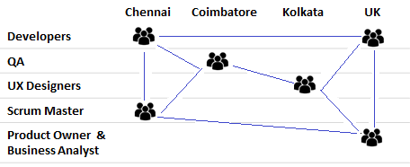
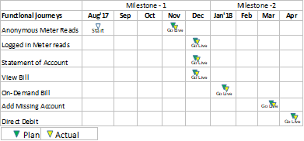
Centrica – Digital Agile Success Story
Centrica – Digital Agile
Distributed Scrum teams: 3 Teams.. 4 Locations… 18 associates
Overview
To move the out of service CQ 5.4 front end implementation of UK Business Digital application to Ember SPAs [Single Page Applications] supported by REST APIs. This will enable to move to cutting edge Digital technology framework which is robust, secure and next gen.
Challenges
COGNIZANT’S SOLUTION
This is the first project executed with fully Offshore teams for both Ember technology and UX designs since the customer was reluctant earlier to try onshore/offshore model
Teams were unable to deliver their best initially due to lack of team cohesiveness / infrastructure support
Team members were made sure to interact face to face with stakeholders on daily basis. This improved both team and customer confidence and also helped in changing the perception of Cognizant's Distributed agile delivery model.
Following multi prong approach was adopted to improve the collaboration across team members
Maximized face to face communication to improve team rapport
Dedicated Video conference room made available for all scrum ceremonies & Enabled Video facility to all the team members’ work station
Leveraged Jira as online project management tool for seamless delivery across different geographies & used the Slack, Skype & GitHub for collaboration
Release timelines / Milestones met
Delivery expectations (Milestones-1) set by the Product owner was met 100% - 4 out of 4 journeys went Live by Dec’17 despite stringent timelines
Best Practices Implemented
People & Process | Requirements | Engineering | Tools & Metrics
Retrospection Stretch goals Commitment based approach Assessments | Relative sizing / Poker planning Backlog grooming session Reverse KT | Technical debt clearance Automation Coding standards – Rule sets Code check in policies | Design – Swagger, Adobe Photo shop Code- Fisheye, GitHub, Sonarqube Metrics : Defect trend , Automation coverage

Slide 20
Centrica
Cognizant’s Transformational Journey Delivering all-round services and mission critical projects for Centrica –
a UK based International Energy Services Company.
Business Context
Cognizant Solution
Outcomes Delivered
Cognizant is a Strategic IT Partner to Centrica since 2008.
As a Digital Transformation Partner –Cognizant has delivered
Data Centre transformation to Nex-Gen Cloud
Transformational projects ever evolving digital space through Micro-services
Digital transformation to Next-Gen Web
Areas of Engagements:
Cognizant has delivered across multiple engagement Comprehensive web and mobility solutions for both internal and external stakeholders
Mobility solutions available across platforms (iOS, Android)
Enterprise Application Services for large transformational projects such as core landscape transformation and more..
Centrica and Cognizant over the years have engaged in multiple engagements for the Digital Transformation Programs.
Cirrus - Digital Transformation Program To Drive Business Transformation Across 9 Key Business Units of Centrica, Is Expected To Save $20 Million Per Year By Leveraging Next-gen Digital Technologies
Hybrid POD model in place - Cognizant developers pairs with clients developers in a POD.
Agile Contracting - All PODs are delivering Greenfield Cloud native app (Java, .NET, Mobile - iOS, Angular)
POD team follows - Pair Programming, DevOps, Agile-XP and Product Management Methodology
Robust Execution
30% Improvement in partner efficiency in UK region capturing more than 250,000 more client enquiries through campaigns
30% Effort reduction of Talent Acquisition executive and Business manager. Can now create job requisition without any support from HR team within 30 min from current 2-3 days.
Cognizant built Partner Enablement Platform enabled running 6 campaigns with 5 different partners and 4 different product combinations targeting 700,000 customers and 80,000 sales.

Slide 21
A multinational energy and utilities services provider
Centrica - AVM
280+ FTEs
120+ Apps
Scope of services
$24.1 M savings
UK, US & Ireland
L1, L1.5, L2, L3 Production Support, Application Management, Development and Testing
197 hours saved through automation
Business Challenges
Solution
Key Benefits & Outcomes
Ensuring same level of knowledge across the team and early onboarding of new team members
Reduction in Resolution time and ensuring quick responsiveness
Shifting manual repetitive tasks to another team
Onboarding new apps without any extra cost
Better adherence to SLA and higher levels of inter-operability
High cost on maintenance and less efficiency in operations.
Operations in siloes, process was inconsistent and with duplication of efforts.
Cognizant provides managed Support services for various applications in different technology landscape serving different business units like Commercial, Residential & Services with a user base of approximately 10K users
Support services provided for 120+ critical customer applications, Databases and tools as part of the support services.
Cognizant proposed L1.5 layer and SME development program
Operations Architecture Review, ITIL Catalog based delivery & Shift Left through KM was performed to ensure quick response
CSI Improvements
58 service improvements and automations were delivered in the first year of automation leading to effort savings of 197 hours and also reduced 908 incidents.
45% tickets are based on Knowledge Error Database with 30% improvement on MTTR and 70% First Level resolution
Reduction in incidents, major incidents, alerts by 26%, 55% & 34% respectively.
40% improvement in the application responsiveness and performance enabling enhanced user experience
Technology Landscape
Transformation Initiative
Automation Benefits
Continued savings of over 1176 hours of efforts per month delivered through automation and process improvements
.NET
Java
Microsoft CRM
SharePoint
Micro services
SSIS
Adobe CQ
SAS
SSRS
BODS
Business Objects
Unix
Delphi
ANSI SQL
PL SQL
Node JS
Aurelia
AKKA
Scala
Application Portfolio Rationalization, Improved Application Availability by timely patching and upgrade of Software/environment
Application Health Management - Improved Turnaround time, High Application Availability, Improved Application Performance
Cognizant’s in-house tools like EnhanC, Genie Lamp etc. and APR framework was utilized for the APR initiative
Productivity Improvements
20% reduction on influx of Tickets.
11M USD+ in Productivity Savings.
No additional cost incurred as all the tools are Cognizant internal tools.

Slide 22


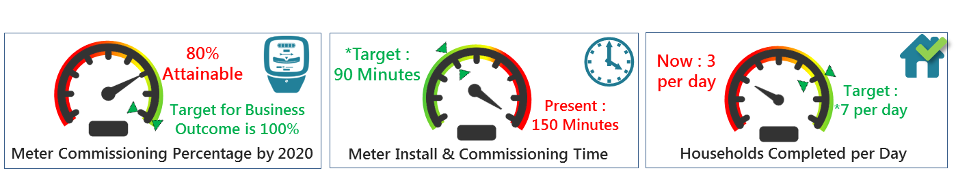
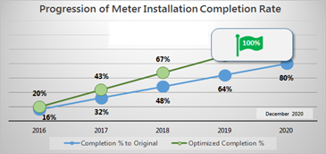

Case Study
Centrica
A successful SMART meter program….
A British multinational utility company supplying electricity and gas in the UK
…generates savings of £2 Billion by 2030 for Government of United Kingdom
…fetches savings of £150 Million in energy bills for the customers by 2020
… helps Utility major meet the mandate by Government of United Kingdom
£
Benchmarking current performance & identifying targets….
Keeping Customer’s ‘Top Business Priority’ as Business Outcome, we found out….
For the
18 Million Smart Meters to be commissioned BY 2020
We studied existing business process, identified KPIs, benchmarked and calculated the targets to meet Business Outcome
In action : Transformation Roadmap resulting in…
Short-fall of savings prevented for UK Government
£410 Mn
Enabling Utility Major achieve 100% by 2020
Short-fall of savings prevented for Utility Major’s Customers
80%
£30 Mn
Would be the forecasted completion only
Savings for Utility Major
£780K

Slide 23
Automation of miscellaneous Invoice Generation
Centrica - RPA
About Client
Customer Need
The Customer is a global Utility major with more than 15 million customer relationships across B2B and B2C segments with more than 10,000 customer service agents catering to Customer needs everyday
.
One of the business units needed sending invoices to customers (Domestic / Business / Bulk) and creating customers on system if not created prior to sending invoice; as this was new business, this process was not integrated into the ERP needing a considerable manual process.
Solution Highlights
Automated end to end process , starting from extracting relevant details and sending invoice to customer
Elimination of agent intervention to send print request of invoice manually
Key Highlights
100% compliance on TAT
~11 FTE Reduction
94% End to End Success Achieved
Business Outcomes
Reduction of back office agents ie.. Opex by an order of £150K per annum
65% reduction in handling time of same transactions (compared with doing manually)
Better Customer experience by sending accurate copies to customer on time
Increased scalability as number of bots can be increased when there is a spike in volumes; allowing launch of new products in market within a short lead time

Slide 24
Creating annual statement for Customers with DQ issues
Centrica - RPA
About Client
Customer Need
The Customer is a global Utility major with more than 15 million customer relationships across B2B and B2C segments with more than 10,000 customer service agents catering to Customer needs everyday
Creation of annual consumption statements for some Customers when their consumption data was erroneous in the billing system. Considerable manual efforts were required (and also with huge seasonal fluctuations) throughout the year. Customer wanted to clean up the errors and create the statements automatically
Solution Highlights
Automated end to end process , starting from extracting exceptions from ERP to sending annual statement to customer
Fetched details from various screens prior to execution of main process to boost efficiency
Key Highlights
100% compliance on TAT
~15 FTE Reduction
60% End to End Success Achieved
Business Outcomes
Savings by an order of £200K per annum
Avoidance of operation issues of moving FTEs across processes due to seasonal fluctuations of volumes; bots could be scaled up or down on demand
End Customers get accurate annual statements (and prevent complaints)
Accurate MI for business leads about the exceptions and backlogs

Slide 25
Automation Case Study – 1 – BGCE MI Health Check Automation
Centrica - Automation
Client:. The Customer is a UK based International Energy Services Company. They supply energy and energy-related services to more than 28 million customers across UK, North America & Ireland
Industry: Energy & Utilities
Region: UK
Business Process Overview
Engagement Highlights
Problem Statement
Solution
Highlights
The documented procedures for BGCE MI Application Health check Automation takes significant efforts of L2 team leading to operational inefficiency & requires manual effort to perform this Health Check Activity.
A workflow was designed in eyeShare Tool (ITPA) to interact with the Applications, Database and checks the job status & disk usage related details. Automated notification is sent to SMEs/support team for both failures and success events resulting in 7.5 hrs /month of effort savings.
This was a scheduled activity which runs twice a day at 11:15 AM & 12:15 PM IST
Assessment Time
8 weeks
Implementation time
7 weeks
Potential Savings
7.5 hours/month
Tool used
eyeShare (ITPA)
Notes:
Sunrun

Slide 26
Automation Case Study – 2 – AUTOCEF Health Check Automation
Centrica - Automation
Client:. The Customer is a UK based International Energy Services Company. They supply energy and energy-related services to more than 28 million customers across UK, North America & Ireland
Industry: Energy & Utilities
Region: UK
Business Process Overview
Engagement Highlights
Problem Statement
Solution
Highlights
The documented procedures for AUTOCEF Application Health check Automation takes significant efforts of L2 team leading to operational inefficiency & requires manual effort to perform this Health Check Activity.
A workflow was designed in eyeShare Tool (ITPA) to interact with the Applications, Database, and checks the job status & disk usage related details. Automated notification is sent to SMEs/support team for both failures and success events resulting in 7.5 hrs /month of effort savings.
This was a scheduled activity which runs twice a day at 11:15 AM & 12:15 PM IST
Assessment Time
8 weeks
Implementation time
7 weeks
Potential Savings
7.5 hours/month
Tool used
eyeShare (ITPA)
Notes:
Sunrun

Slide 27
Automation Case Study – 3 – CHI Interface Health Check Automation
Centrica - Automation
Client:. The Customer is a UK based International Energy Services Company. They supply energy and energy-related services to more than 28 million customers across UK, North America & Ireland
Industry: Energy & Utilities
Region: UK
Business Process Overview
Engagement Highlights
Problem Statement
Solution
Highlights
The documented procedures for CHI Interface Application Health check Automation takes significant efforts of L2 team leading to operational inefficiency & requires manual effort to perform this Health Check Activity.
A workflow was designed in eyeShare Tool (ITPA) to interact with the Applications, Database, and checks the job status & disk usage related details. Automated notification is sent to SMEs/support team for both failures and success events resulting in 7.5 hrs /month of effort savings.
This was a scheduled activity which runs twice a day at 11:15 AM & 12:15 PM IST
Assessment Time
8 weeks
Implementation time
7 weeks
Potential Savings
7.5 hours/month
Tool used
eyeShare (ITPA)
Notes:
Sunrun

Slide 28





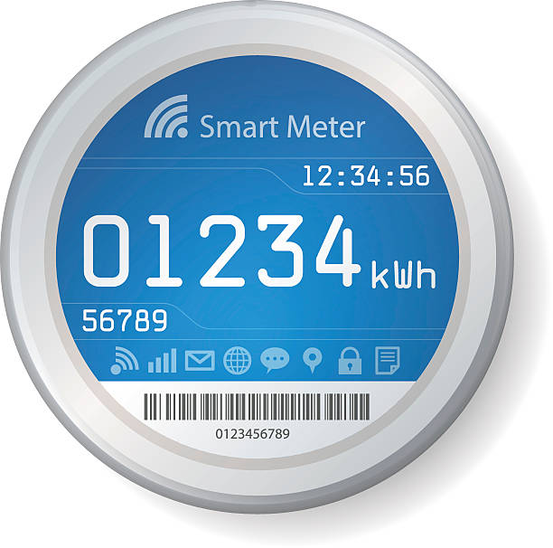
Centrica – large scale automation
Centrica - Automation
Digital Engineering │ Automation
Business Processes
Infra. Ops. & Application Services
Application Engineering
Business Process Automation
Application Maintenance & Support
Digital Development
Established and Operates a Global CoE | 10 Business Processes Automated thru RPA Factory (50 FTE Reduction (66%) | 73% AHT Reduction) | Delivering GDPR Automation
35% Zero Touch Resolution (DB) | 1000+ Incident Resolution p.m. thru Automation | 15% Opex Reduction | 95% MTTR Improvement
88% Unit Test Automation | 50 Builds p.m. | 25 Deployments p.m.
Cirrus KPIs to be entered here
Business Solutions
Data Centre Operations
Quality Assurance
99% Smart Meters (4.7m) on Latest Firmware | 35% Remote Resolution for Inactive Smart Meters
Server Build Time Reduction by 40% | 50% Automation Penetration (over current service) | 60% Automation of Reporting
76% Automation of Regression | 75% Automation in Device Testing
Cirrus KPIs to be entered here
Innovation
(MVPs)
Voice Automation
Email Response Automation
Smart QA with Robotic Arm
Alexa for Customers | Cortana for Engineers
ML/NLP for ERMS Automation
TeBOT with Robotic Arm for Smart Meter QA

Slide 29



Enterprise Test Factory for Leading UK Based Utilities Company
Centrica
Test Factory
2016-17
TRANFORMATION
KEY LEVERS
PEOPLE
PROCESS
TOOLS
2015-16
TRANSFORMATION
2013-15
TEST FACTORY
2010-12
IMPLEMENTATION
Lithium Contract win as a priority vendor
SMART meter testing
Automation proposal for Mobile Testing & SMART
Web services/ API Automation using Postman
Implemented Service Virtualization
Implemented Continuous Integration
2008-10
ENHANCEMENT
ADPART Implementation
Static testing
Lifecycle Automation
Integrated Tool Development Program
One BAU Model
Cloud Testing
Demand testing
Crowd sourcing
2005-07
FOUNDATION
Test Consolidated model
Proposed managed test Centre for digital portfolio
Reduced cost, Improved quality and team effectiveness
Signed for Enterprise wide Test Factory
Started BGS Test center
Created a World class QA organization
Testing services for all projects in Service BU
Digital Transformation
Agile Testing
Established
Presence in BI BW, SAP ISU, Mobile, Handheld testing, CRM, MS SQL and BAU, Service Recovery
Started BI, SAP BW and IS-U Automation
Share Point Application
Testing
Website Enhancement Testing
Introduction of
BA-QA Model
Managed Testing Services for all testing needs
60%
69%
25.5%
100%
40%
80%
Test Automation resulting in 75% Manual Effort savings
Increase in Productivity
Effort saved using ADPART & TD Development
Schedule Adherence despite 46% annual growth in work volume
Effort saved using CSmart Mobile automation
Effort saved using Nth Sprint Automation
Relevance to UA

